Slide 1



Welcome!
Python for Beginners
Thank You to Our Sponsor
@gdifortcollins

Slide 2
Introductions &
Announcements

Slide 3
Welcome!
Girl Develop It is here to provide affordable and accessible programs to learn software through mentorship and hands-on instruction.
Some "rules“…
We are here for you!
Every question is important
Help each other
Have fun
Girl Develop It is here to provide affordable and accessible programs to learn software through mentorship and hands-on instruction.
Some "rules"
We are here for you!
Every question is important
Help each other
Have fun
WHAT WE WILL COVER TODAY
Why Python?
What is programming?
Variables and arithmetic
Statements and Error Messages
Development Environment Setup
WHY PYTHON?
Suitable for beginners, yet used by professionals
Readable, maintainable code
Rapid rate of development
Few "magical" side-effects
Variety of applications
WHAT IS PYTHON USED FOR?
System Administration (Fabric, Salt, Ansible)
3D animation and image editing (Maya, Blender, Gimp)
Scientific computing (numpy, scipy)
Web development (Django, Flask)
Game Development (Civilization 4, EVE Online)
QUESTIONS?
Intro to Python ~ Girl Develop It ~

Slide 4
Today We Will …
Learn About the Python programming language
Install Python 3
Use the Python shell and IDLE
Print output
Get input from a user
Learn about :
Data types like Strings & Integers
Creating and using variables
If/then/else decision making (conditionals)
Loops
Create Simple Games Using Python
HAVE FUN!

Slide 5



What is Python?
Guido Van Rossum

Slide 6
Why Python?
Easy to Use
Powerful
Object-Oriented (OOP)
“Glue” Language
Runs Everywhere
Free
Open-Source
Strong Community

Slide 7
Let’s Get Started Programming!

Slide 8
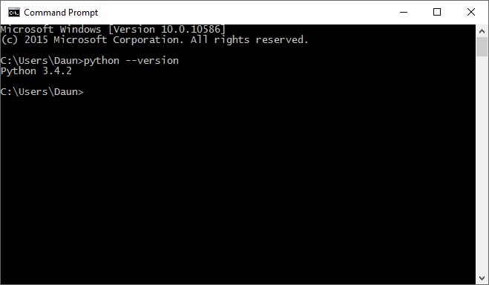
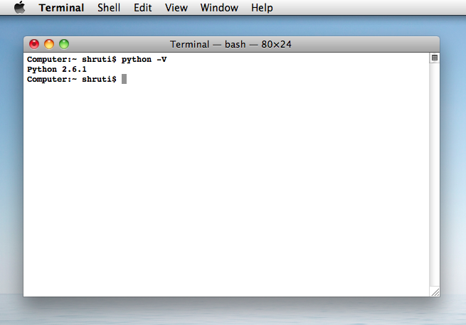
Do You Have Python Installed?
Launch The Command Prompt From The Run Window. One of the quickest ways to launch the Command Prompt is to use the Run window (press Win+R on your keyboard to open it). Then, type cmd or cmd.exe and press Enter or click/tap OK.
You can also launch it from the start menu or use Cortana on Windows 10.
The Terminal is a program included with all versions of Mac OS X. It is located in the Utilities folder within the Applications folder.

Slide 9
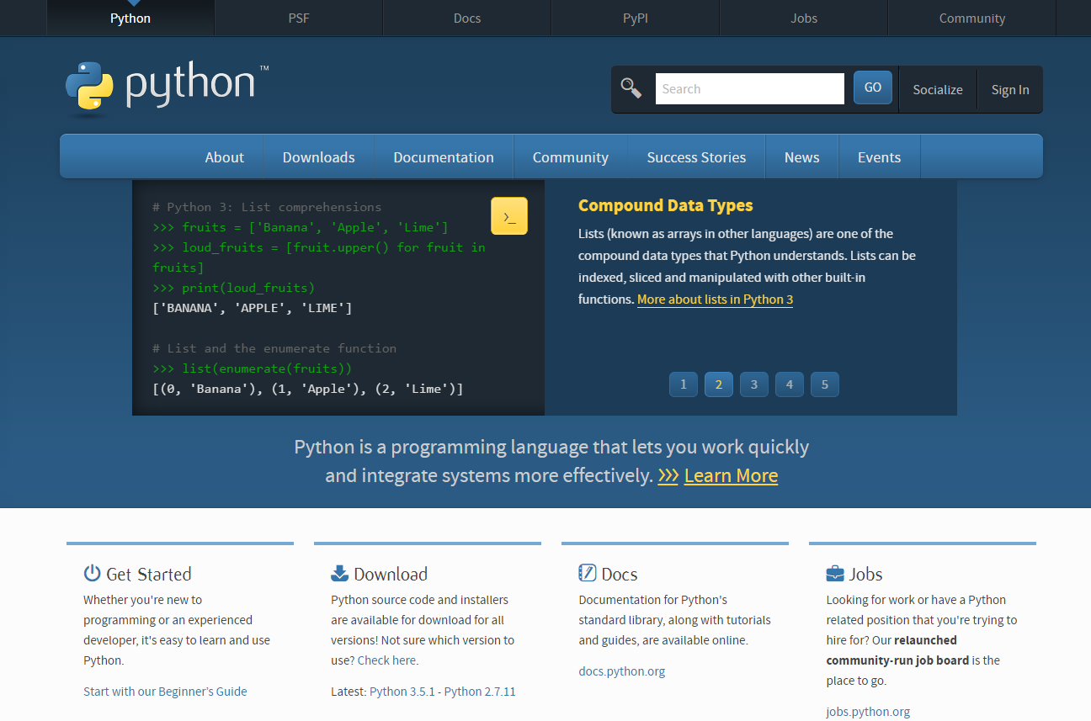
Python.org

Slide 10
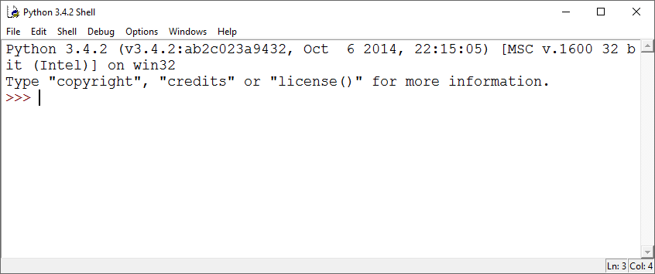
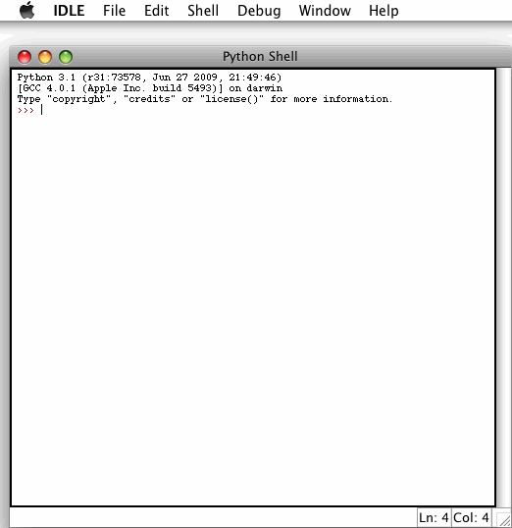

Start IDLE (Python GUI)
Integrated
DeveLopment
Environment

Slide 11
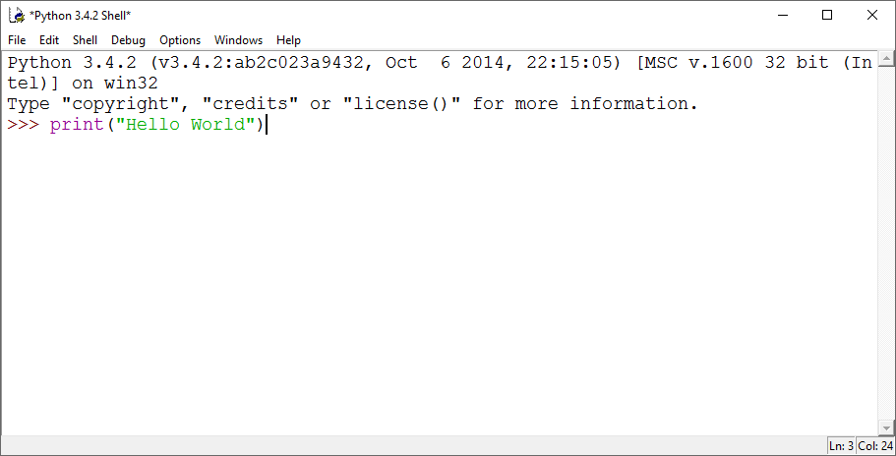
Your First Python Program
Using the Python Shell, type the statement.
Then hit the Enter Key to run the program.

Slide 12
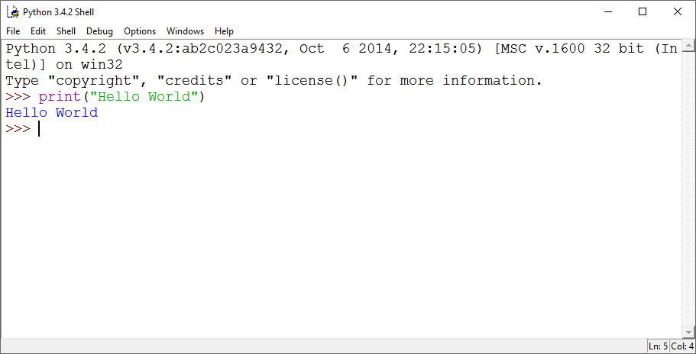

Your First Python Program
Congratulations!
You can see the output of the program on the line below where it was typed.

Slide 13

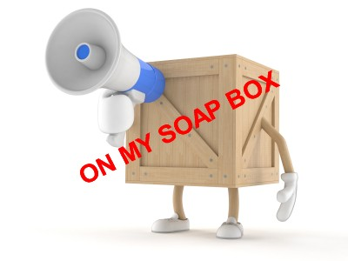
Let’s Have a Talk About Jargon

Slide 14
Jargon
Program / Code :
Sequence of instructions for a computer to perform
Function :
Mini-program with one specific task

Slide 15
Jargon
“Call a Function” :
Tell a function to execute
“Pass An Argument” :
Give information to a function to use when it’s executing

Slide 16

Example of a Function
print()
Followed by parentheses!!
Function Name

Slide 17
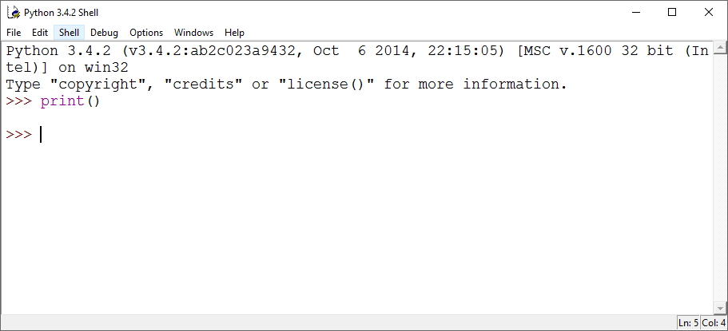
Try This…
We don’t pass the print() function an argument. What happens?

Slide 18
Passing Arguments to A Function
print(“Hello World!”)
Function Name
String Argument
String : Series of Characters aka Text / Words surrounded by double quotes.

Slide 19
Idle helps you with colors

Slide 20
Jargon
Statement :
One complete instruction for the computer
Coding :
Writing code aka programming

Slide 21
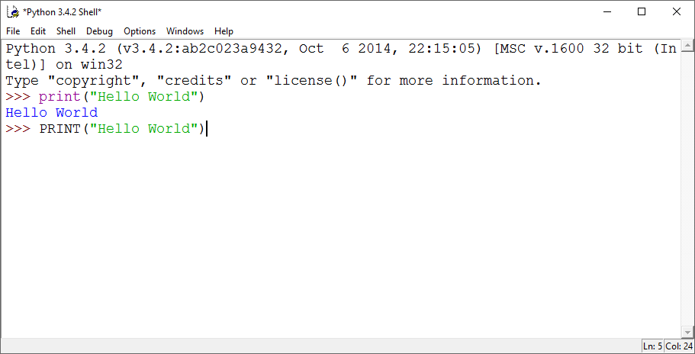
Try This…
Type PRINT
Exactly
Like This

Slide 22

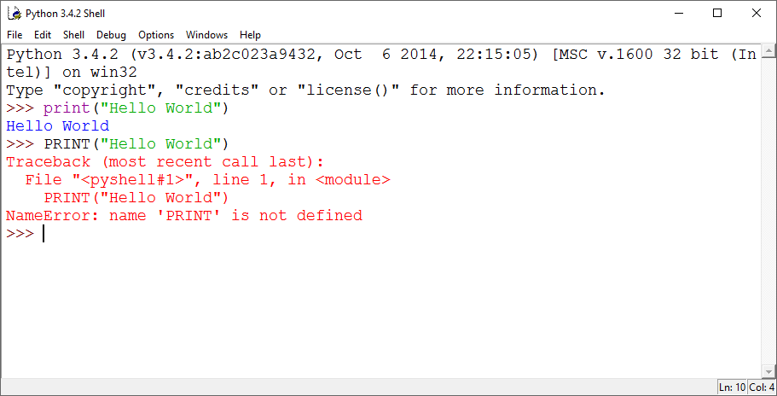
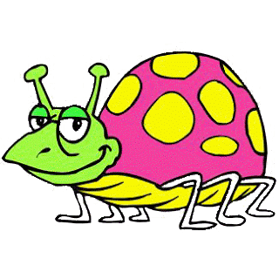
Oops! What Happened?
Say Hello to your First Bug!

Slide 23

Jargon
Bug :
An error in your computer program … when your program doesn’t work as expected.
Debug :
Find and fix the error in your program to make it work as expected.

Slide 24
Oops! What Happened?
Python is
CASE-SENSITIVE.
When you get an Error
Notice the COLORS!
Notice what the error information tells you.

Slide 25
Jargon
Syntax Highlighting :
Color Coding used to help a programmer quickly identify parts of the code.
Purple : Parts of the Python Language
Green : Strings
Blue : Output from the program

Slide 26

Jargon
Coder / Programmer :
Someone who writes and debugs code ….YOU!

Slide 27

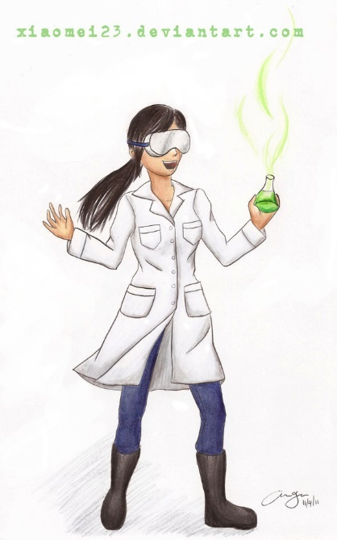
Python Shell / Interpreter
REPL – Read Eval Print Loop
three
greater-than
signs
Interactive Mode
Immediate Feedback.
Quick Easy way to test out code.

Slide 28
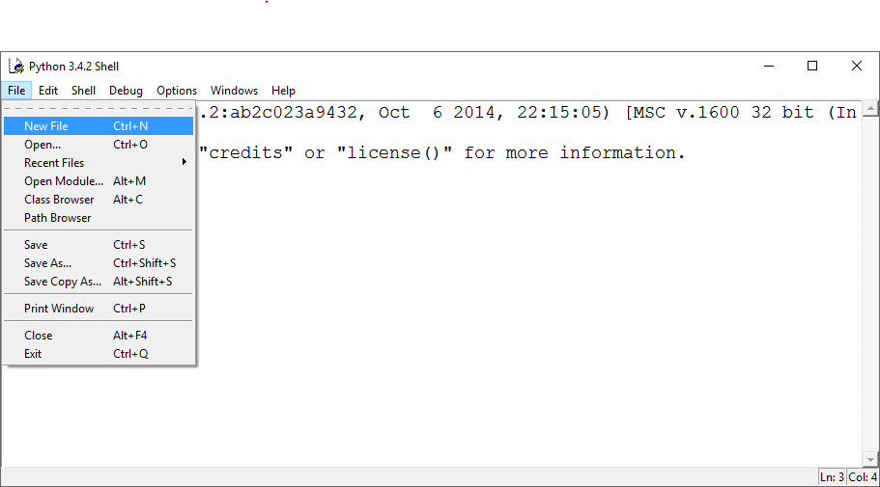
Script Mode
Like a Word Processor for Writing Programs

Slide 29
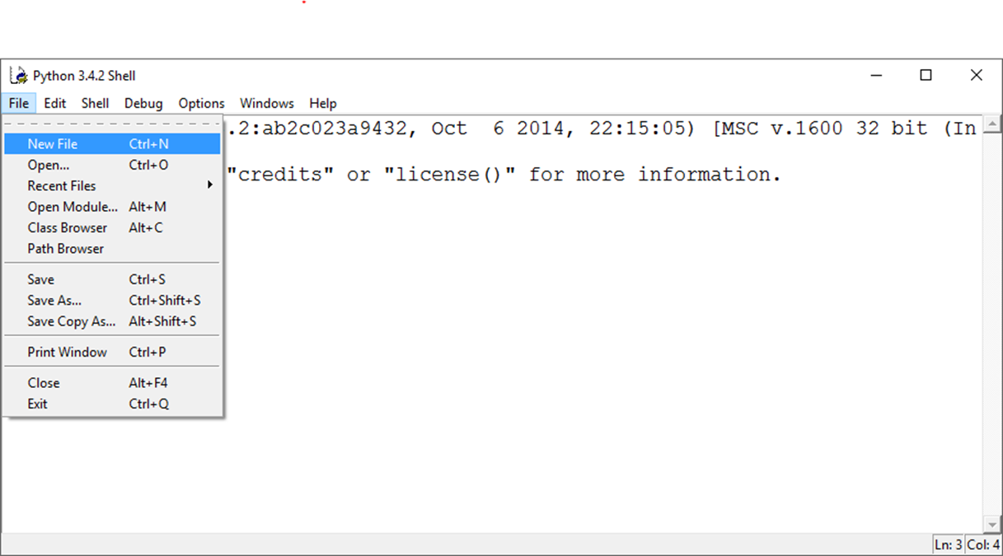
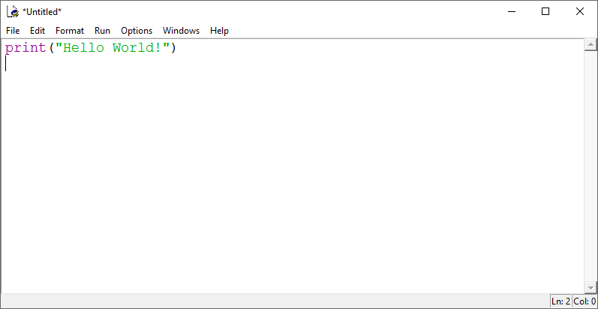
Your First Python Program(Again)
Open a new file.
Type your program.
Then We need to save the program before we can run it.

Slide 30
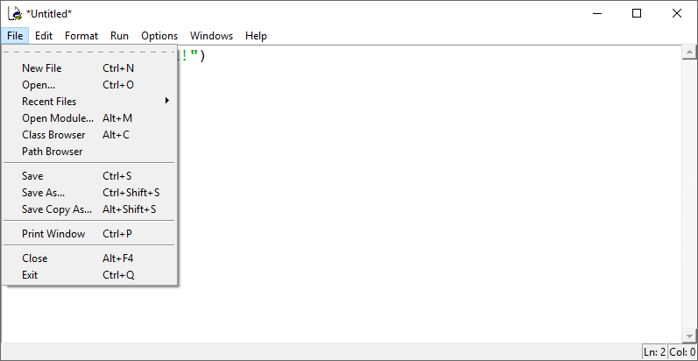
To Save Your Program

Slide 31
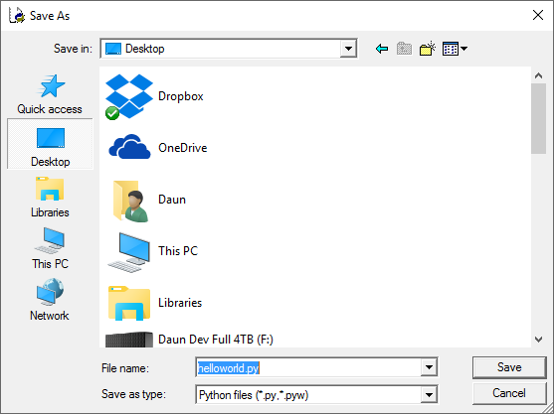
To Save Your Program
Use .py extension to name it!

Slide 32
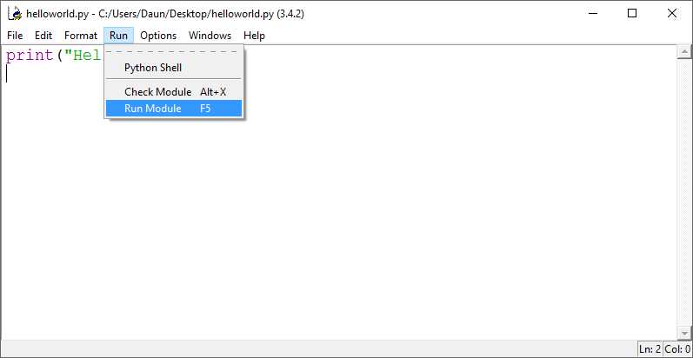
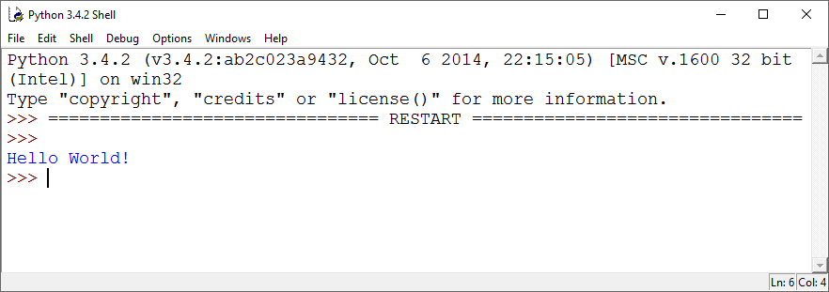
To Run Your Program (First Method)
Output shows in the Python Shell

Slide 33

To Run Your Program (Second Method)
Find where you saved the file.
Double – Click Icon
What Happens?

Slide 34
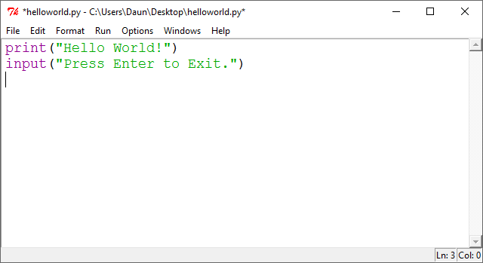
Let’s Use a New Function
Open a new file and type the following:
The input() function waits for user input and then the enter/return key to be pressed.
You can “pass an argument” that prints a prompt before it waits for the return key.

Slide 35
To Run Your Program
Find where you saved the file.
Double – Click Icon
What Happens This Time?

Slide 36
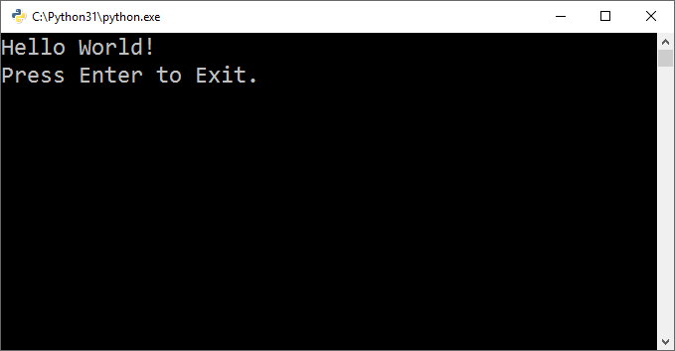
The terminal or console window will remain open until the user hits the Enter key.
Then the operating system (Mac or Window or Linux) closes the window.

Slide 37
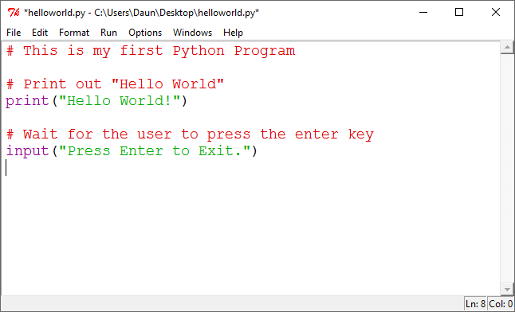
#
Let’s Add Comments!
Use the # number or hashtag symbol to add a human readable statement
Notice the new color to indicate comments is RED.
Everything following the # symbol is ignored by Python
But a human programmer can read it for information.
Save & Run Your Program Again … It should work the same.

Slide 38
What We Learned So Far
Python is a powerful easy language to learn programming.
Idle - Integrated DeveLopment Environment
Idle has two modes:
Interactive Mode :
>>> on the screen
responds immediately to commands
Script Mode :
Use File->New File to write a program
We learned Two functions :
print() : prints out a string
input() : asks for input and waits for user to type the Enter key
We learned how to add comments
# this is a human readable comment that Python ignores

Slide 39
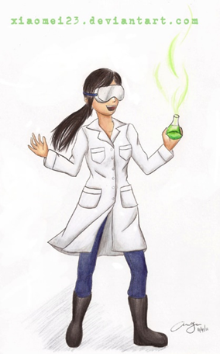
Working Break Time
Write your own Python program that prints out at least two lines.
Be sure to use the input() function to wait for the user to press a key.
Run it using both methods.

